Slide 1


Problem statement
This project involved creating a comprehensive data analytics solution for AtliQ, a hardware manufacturing company. As AtliQ expanded into Latin America, they faced significant financial losses due to decisions based on personal intuition rather than data. To address this, they hired a data analyst to bring transparency and enable data-driven decision-making using Power BI.

Slide 2
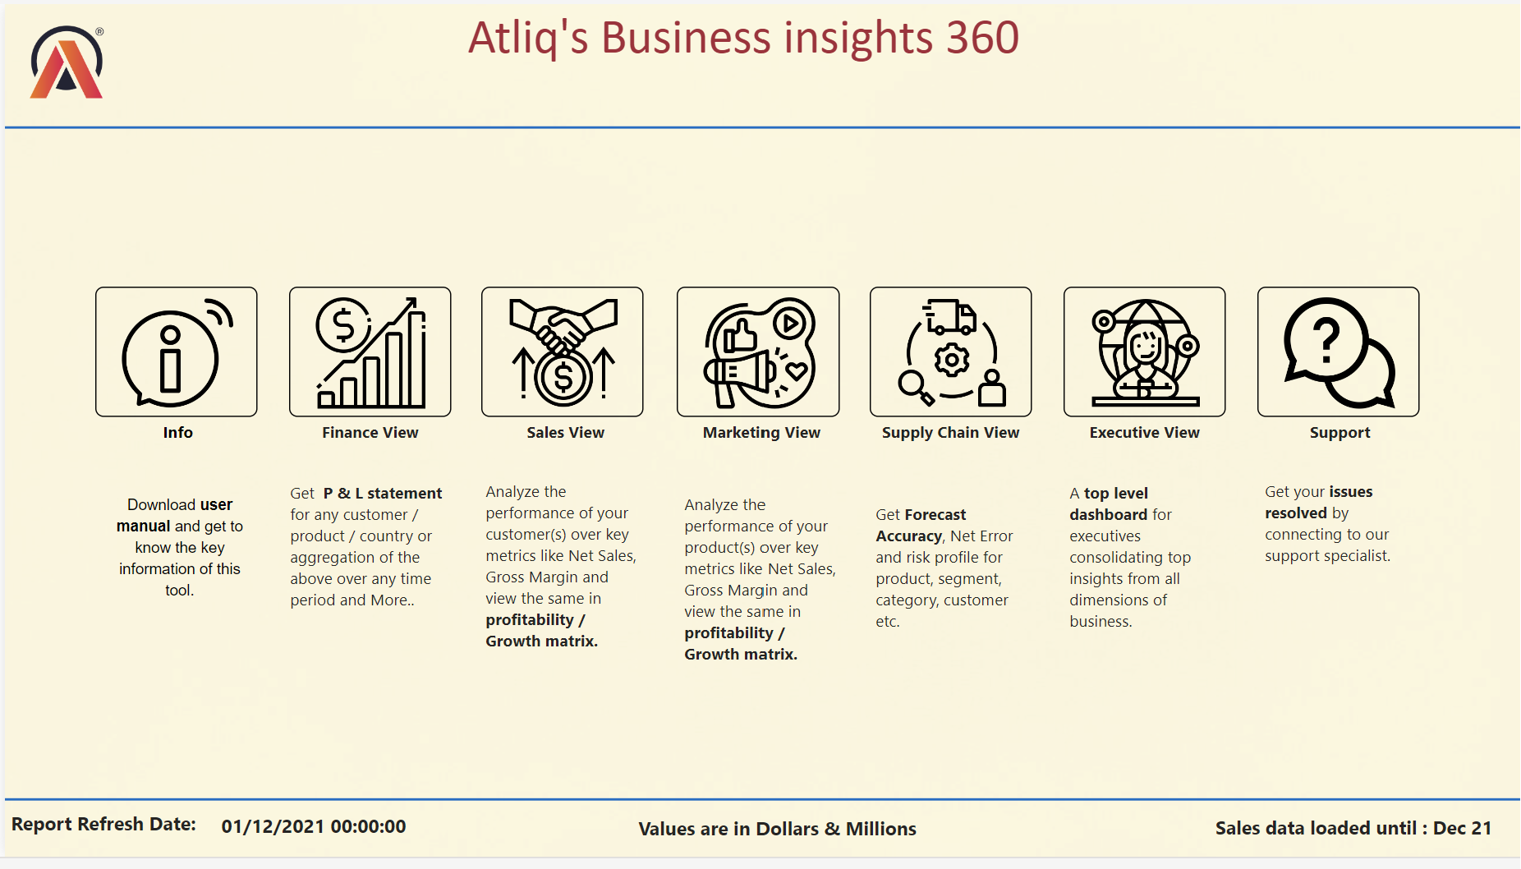

Slide 3
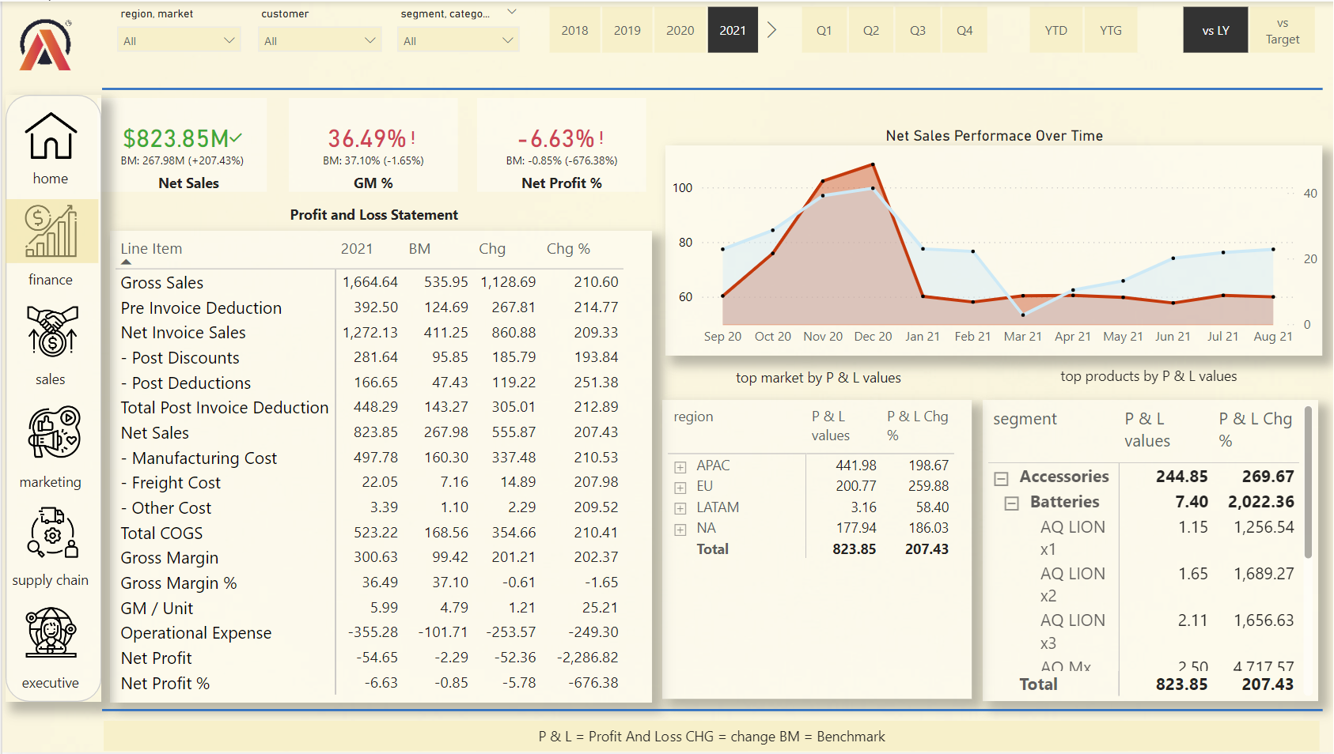

Slide 4

Insights
The significant increase in net sales (+207.43%) indicates strong performance.
The slight decrease in gross margin percentage (-1.65%) suggests potential cost management issues or pricing strategy adjustments.
The considerable drop in net profit percentage (-676.38%) highlights a critical area for investigation, possibly due to increased operational expenses or other unexpected costs.
Regional performance shows APAC as the leading market, while LATAM shows minimal contribution.
Product-wise, accessories contribute significantly to P & L, while batteries show high variability.

Slide 5

Recommendations
Investigate the reasons behind the high operational expenses impacting net profit.
Explore strategies to improve gross margin, possibly through better cost control or pricing adjustments.
Focus on boosting sales in underperforming regions like LATAM.
Continue leveraging high-performing product segments like accessories, while addressing issues in the batteries segment.

Slide 6
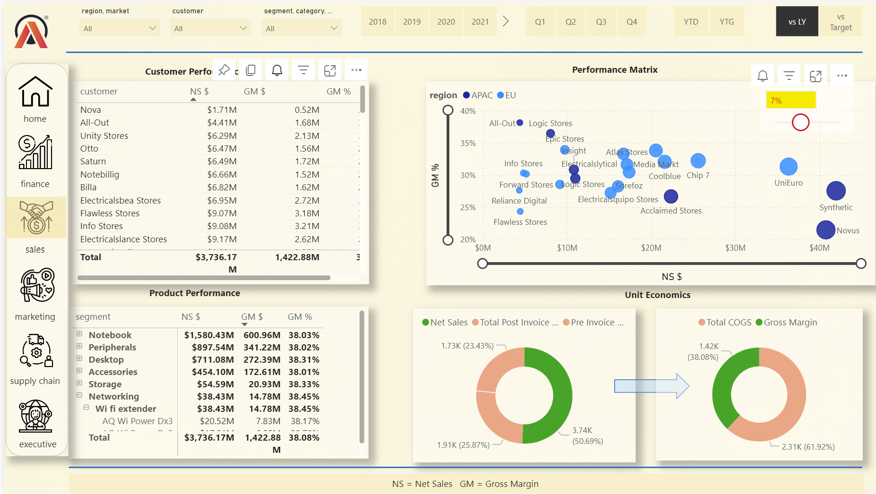

Slide 7

insights
The significant increase in net sales (619 Millions) by customers indicates strong performance.
Some of the customers are not meeting the targets gross margin requirements.
Amazon as customer and AQ smash 2 gaming laptop as product have the highest gross margin and net sales.
Elecetricalsquipo store has the highest Gross margin target tolerance gap.

Slide 8

Recommendations
Focus on increasing Net Sales and Gross Margin percentage of most of the customers.
Customer like Nova and All-Out need attention as they have the least sales as well product’s category like Wifi-extender also need to be taken care .
Explore strategies to improve gross margin, possibly through better cost control or pricing adjustments.
Focus on boosting sales in underperforming regions like LATAM.
Continue leveraging high-performing product segments like accessories, while addressing issues in the batteries segment.

Slide 9
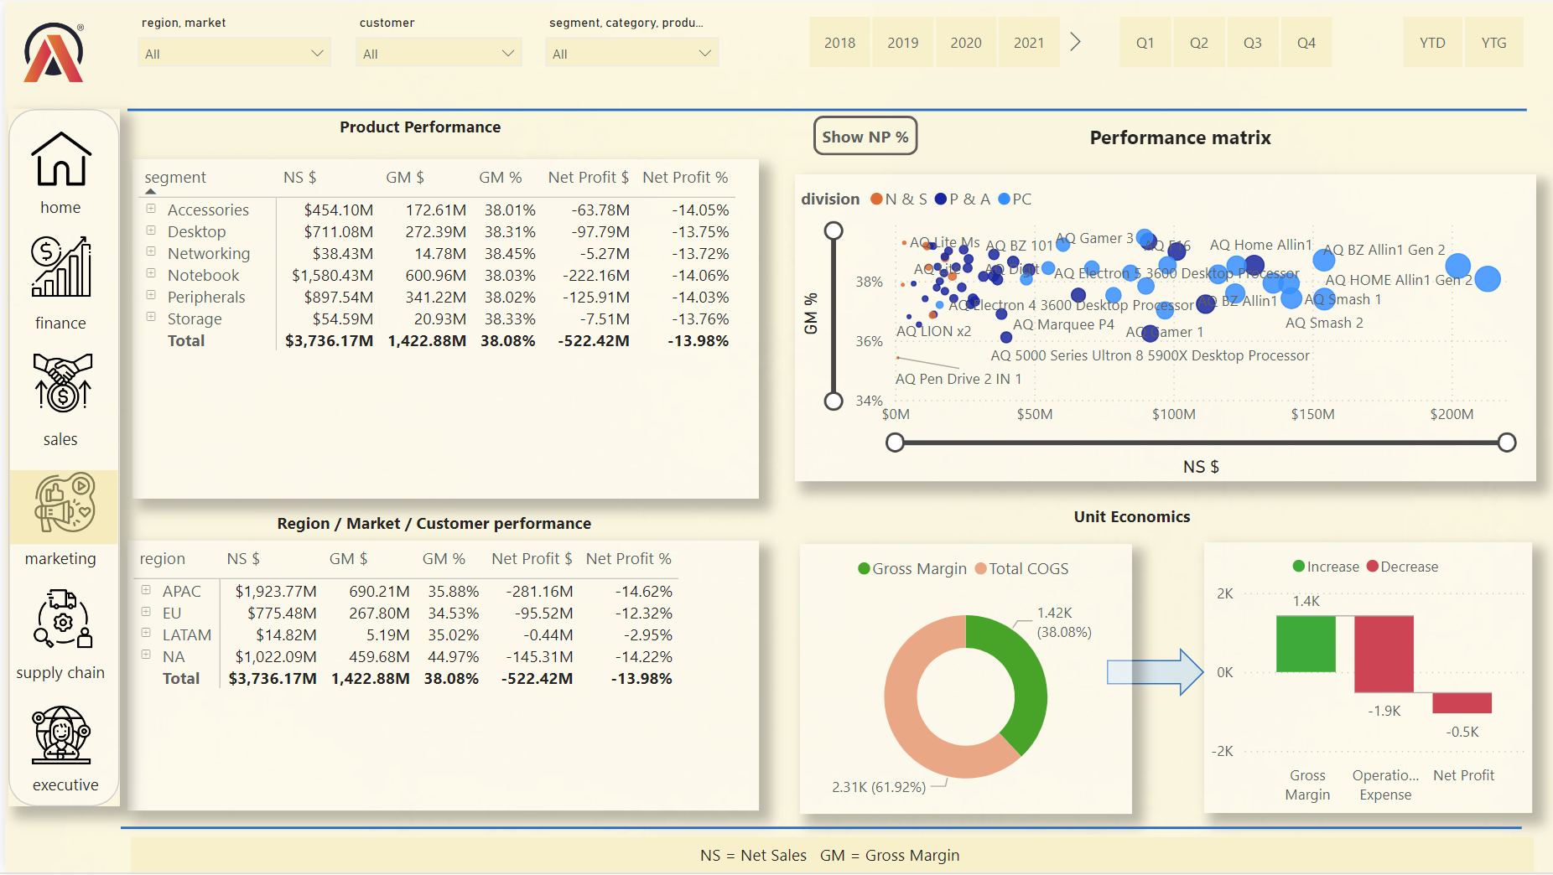

Slide 10

insights
While products like Accessories and Notebooks generate high net sales, their net profit percentages are negative, indicating high operational expenses or other cost issues.
Batteries have a small contribution to net sales but show a significant negative net profit percentage, indicating the need for cost optimization or pricing strategy adjustments
The scatter plot helps identify products with high net sales and high gross margins, indicating profitable segments.
Products clustered with low net sales and low gross margins need attention for performance improvement.
The gross margin represents a healthy percentage of net sales, but the increase in operational expenses is a concern, significantly impacting net profit.

Slide 11

Recommendations
Evaluate the feasibility of continuing underperforming products like Batteries.
Analyze the components of operational expenses and identify areas for cost reduction.
Implement strategies to improve net profit while maintaining or enhancing gross margin.

Slide 12
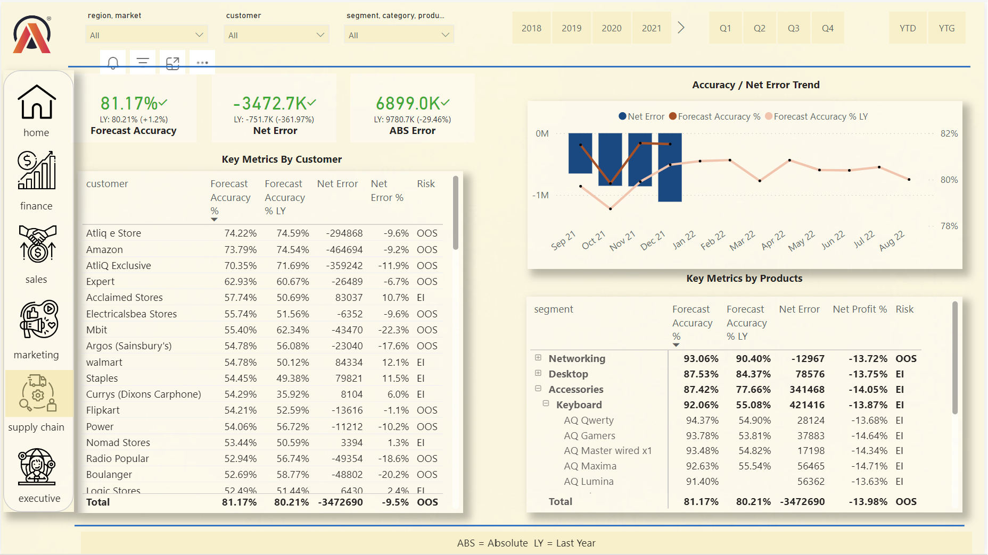

Slide 13
insights
Overall, the forecast accuracy is high and shows improvement over the previous year.
Significant net errors are observed in certain customers and product segments.
Both "Excess Inventory" and "Out of Stock" risks are present, suggesting a need for better inventory management.

Slide 14

Recommendations
Focus on customers like Circuit City, BestBuy, and Billa to understand the factors affecting forecast accuracy and take corrective measures.
Address "Excess Inventory" and "Out of Stock" issues by refining inventory management strategies for specific segments, particularly Peripherals and Storage.
Investigate the reasons behind high net errors and negative net profit percentages for segments like Accessories and Notebooks. Implement
Continuously monitor forecast accuracy and net error trends. Adjust
Develop tailored strategies for key customers with high net errors and risk levels to enhance their performance and reduce associated risks.

Slide 15
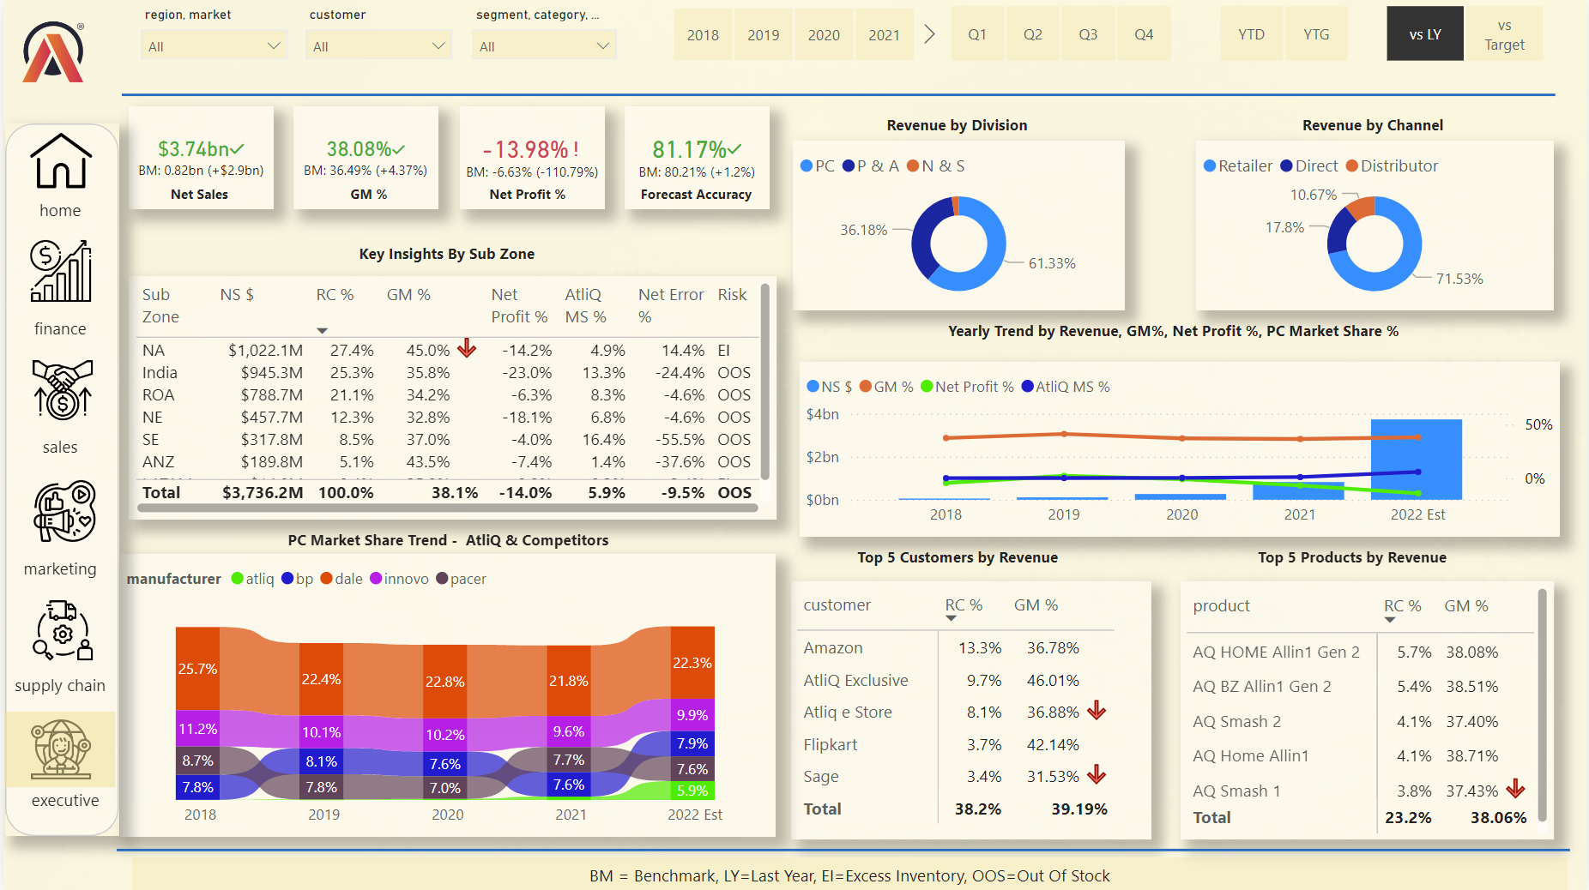

Slide 16

insights
Atliq has consistently maintained a market share around 7.6% to 8.7% from 2018 to the 2022 estimate.
Competitors like BP, Dale, Innovo, and Pacer have also shown stable or fluctuating market shares.

Slide 17

RECOMMENDATIONS
Focus on optimizing the cost structure and increasing operational efficiencies, especially in high-revenue regions like North America and India, which have significant negative net profit percentages.
Address the issues of Excess Inventory (EI) in North America and LATAM.
Resolve Out of Stock (OOS) problems in regions like ANZ and India to improve net error percentages.
Strengthen relationships with Retailers, as they contribute the highest revenue (71.53%).
Explore opportunities to grow Direct and Distributor channels to diversify revenue streams.
Promote high-revenue products like AQ Home Allin1 and AQ BZ Allin1 Gen 2 to increase their market share and profitability.

Slide 18
Thank you
Presented by Sahil Shah Learning is a journey that never ends, a path of discovery and growth where the destination is wisdom, and the scenery along the way is the beauty of understanding.

